Slide 1


Heart disease diagnostic analysis
Analysis by: Deepan R
UNID: UMIP5710

Slide 2


Key performance INDICATORS - KPI' S
Blood Pressure
Sugar level
Thal
Chest pain type
Calcium level
Gender
Age
Exercise
Old Peak
Slope

Slide 3

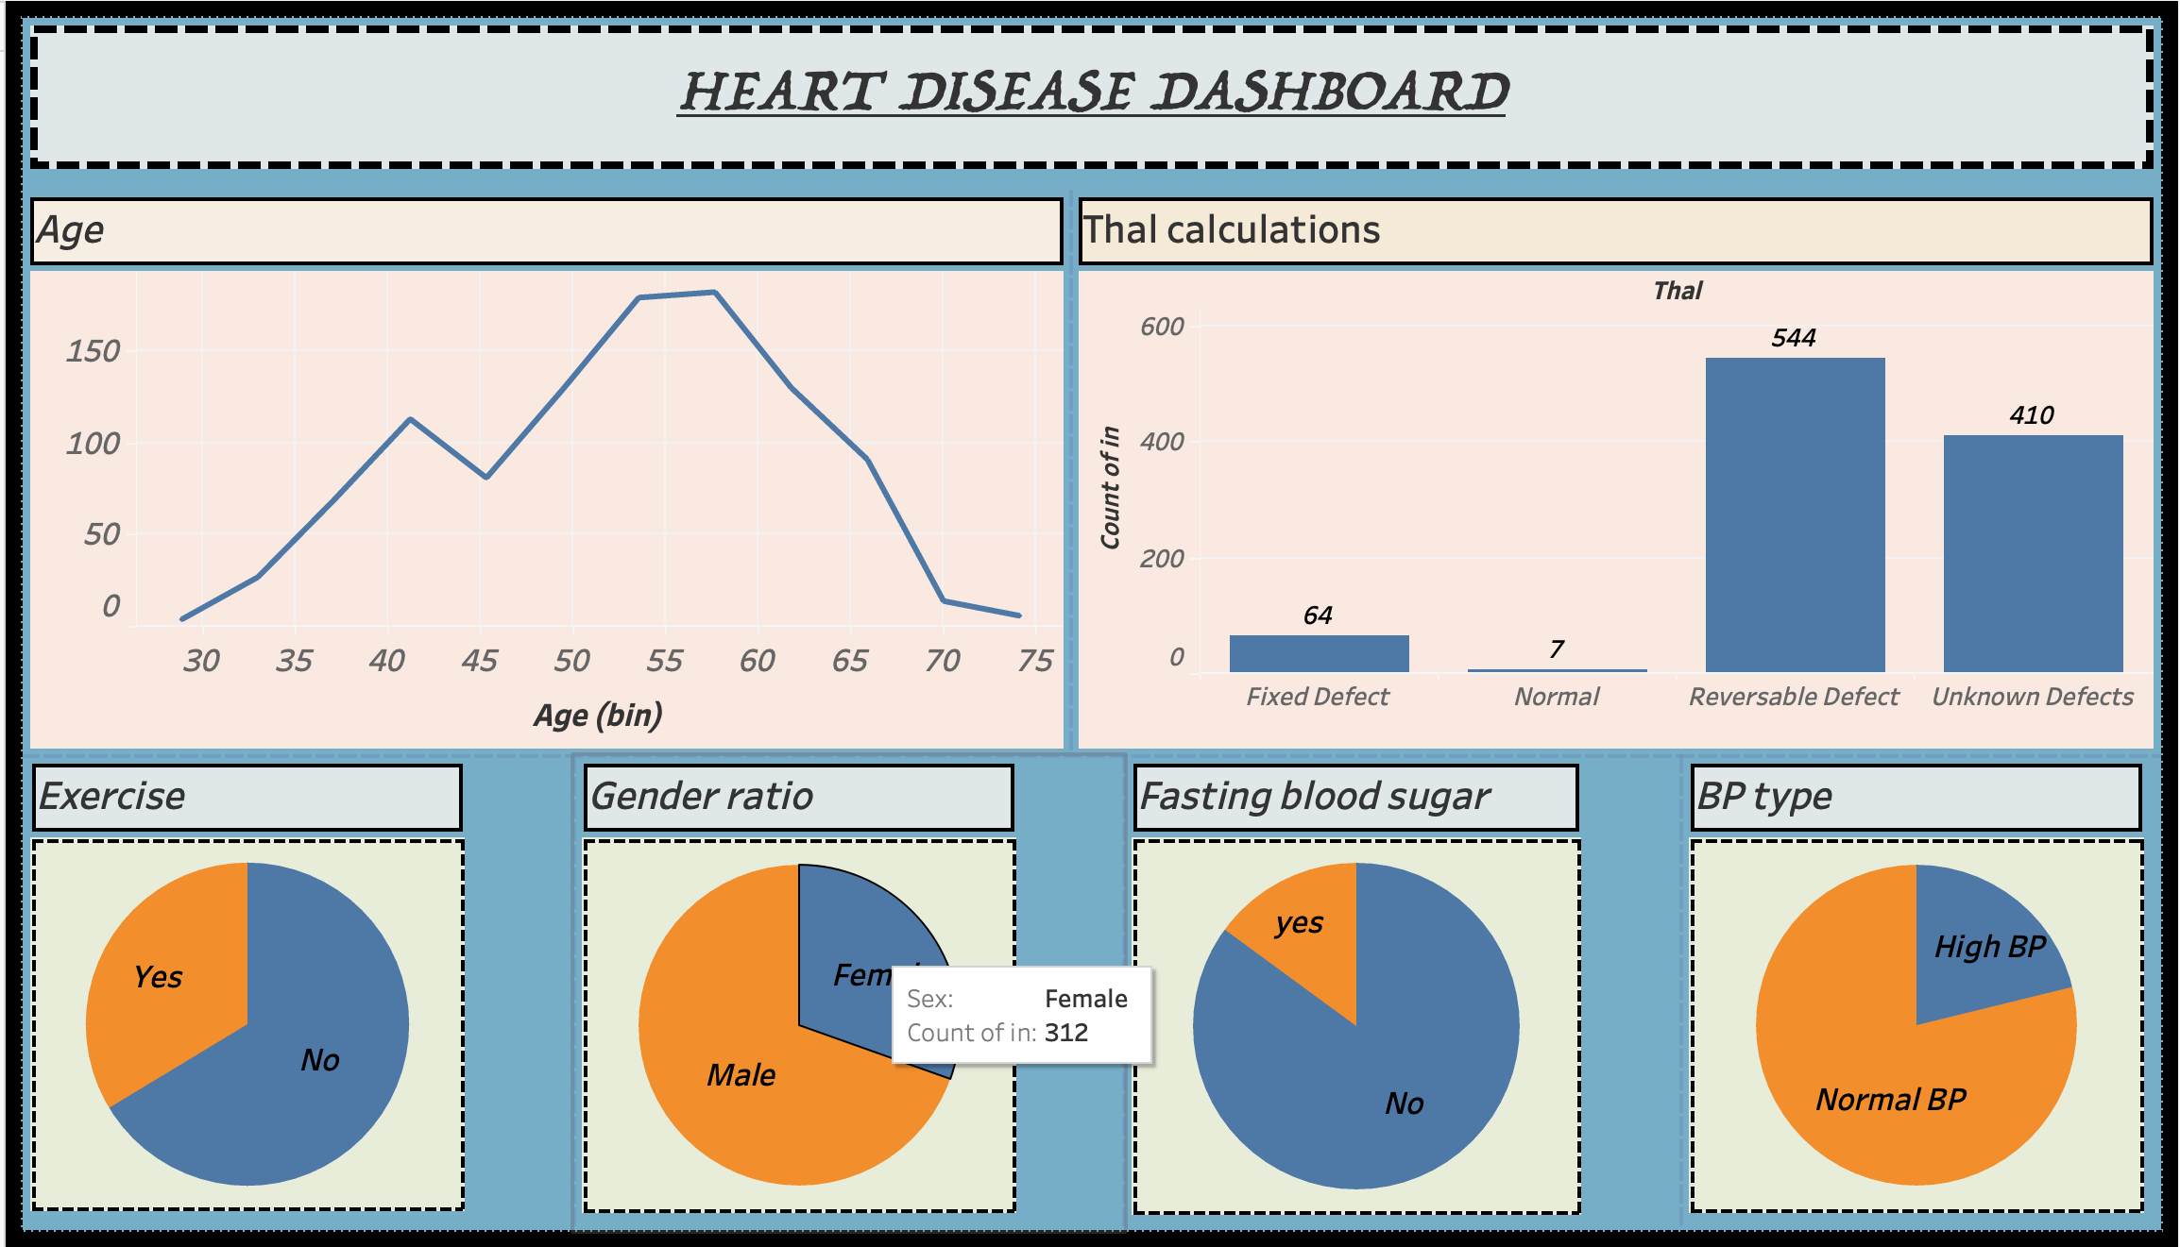
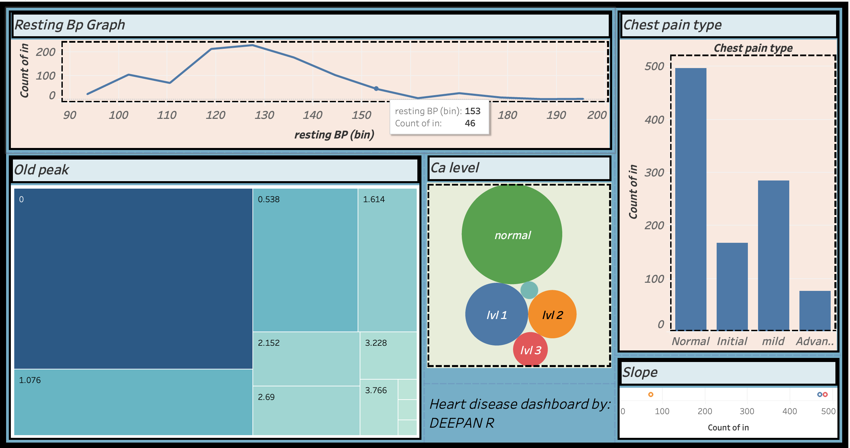
dashboard

Slide 4


ANALYSIS
Calcium level is Normal for almost everyone
No fasting blood sugar present
Normal blood pressure is observed
In most of the cases defects based on Thal calculations is either reversable or unknown
People of age group 50-55 have had heart disease
65% are men and 312 people are female
Chest pain type is normal
Resting bp is 120-130 in most cases
Old peak with 0 is in most of the cases

Slide 5

Thank you !

